Slide 1

NBA Player Performance Analysis
by Risal Andika

Slide 2
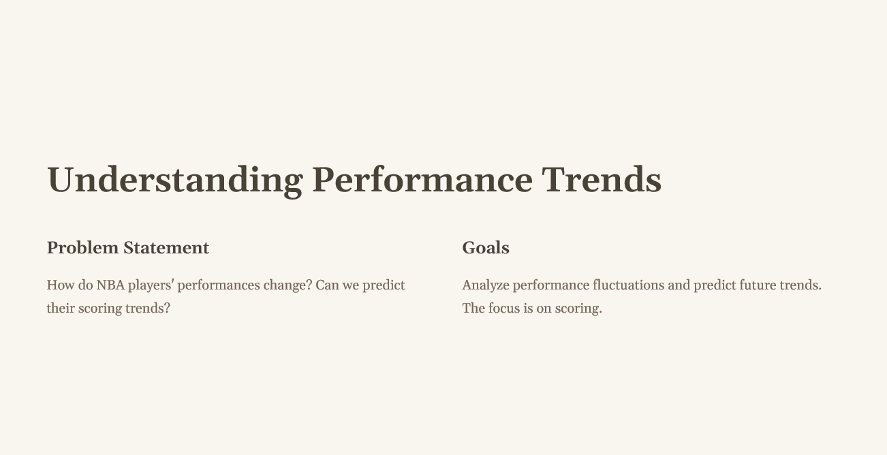

Slide 3
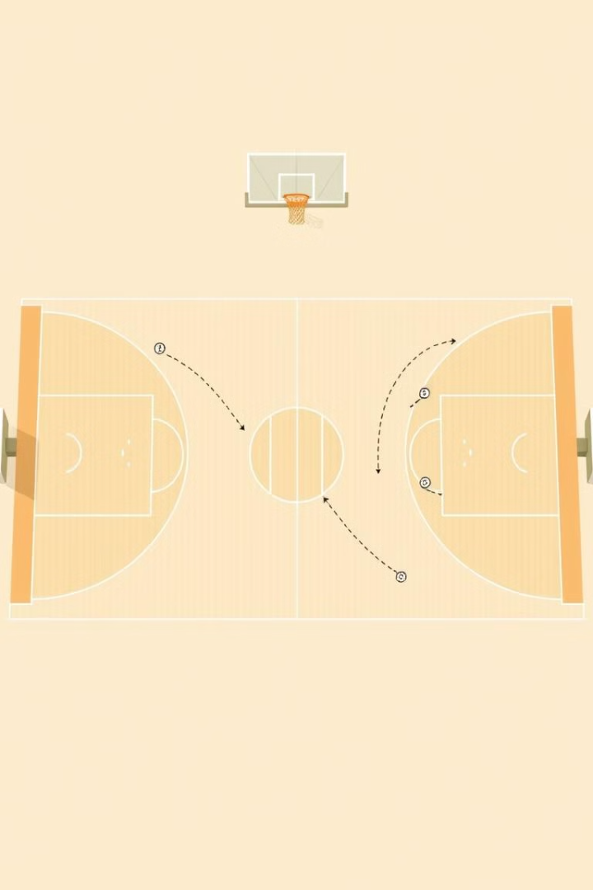
EDA Highlight
1
Top 10 Players
Identify top scorers and their performance trends over time.
2
Trend Analysis
Analyze changes in points, assists, and rebounds monthly.
3
Correlation Analysis
Determine which stats most impact points (AST, TRB, FG%, 3P%).
4
Seasonal Variations
Explore performance fluctuations across months/weeks.

Slide 4
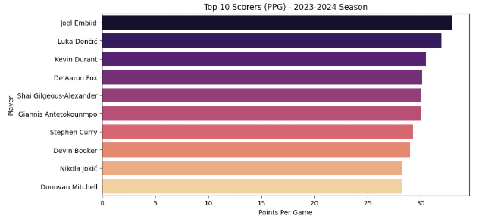
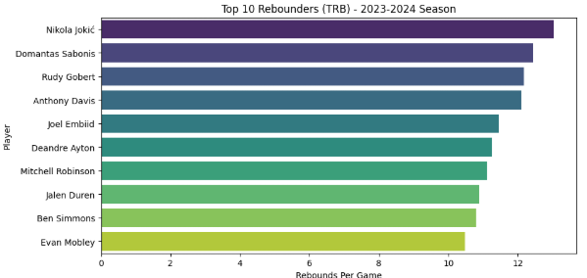
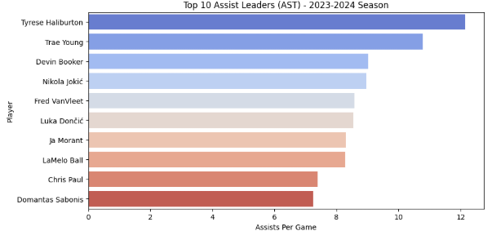
EDA 1. Top 10 Players based on PPG, ATS and RBD
🔥 Key Takeaways:
✅ Joel Embiid is the most dominant scorer while also being a top 5 rebounder—a complete big man. ✅ Luka Dončić balances scoring and playmaking, appearing in both PPG (31.96) and AST (8.55) lists. ✅ Nikola Jokić is the most well-rounded player, ranking top 10 in PPG, AST, and TRB, reinforcing his MVP-caliber impact. ✅ Devin Booker’s assist numbers (9.02 APG) show his evolution as a playmaker while maintaining elite scoring. ✅ Tyrese Haliburton’s playmaking dominance (12.15 APG) sets him apart, making him an offensive engine.

Slide 5
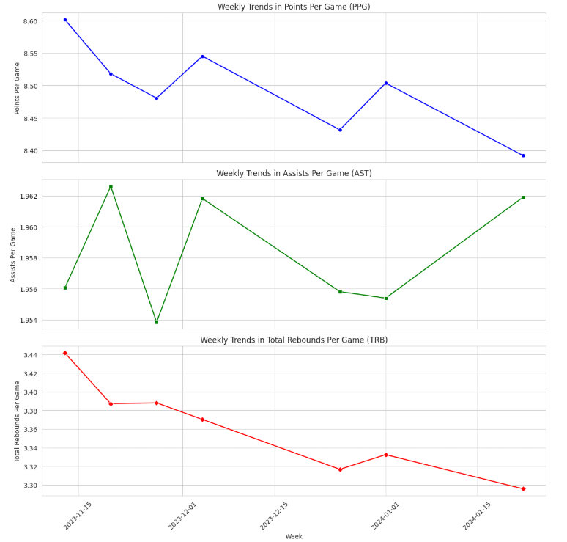
EDA 2. How About The Trend?
🔥 Key Takeaways
✅ PPG is on a slight decline, possibly due to defensive adjustments, fatigue, or season pacing. ✅ AST remains steady, implying consistent playmaking trends with no major shifts. ✅ TRB is declining, which may indicate teams taking more perimeter shots (reducing rebound chances) or improved defensive boxing-out strategies.

Slide 6
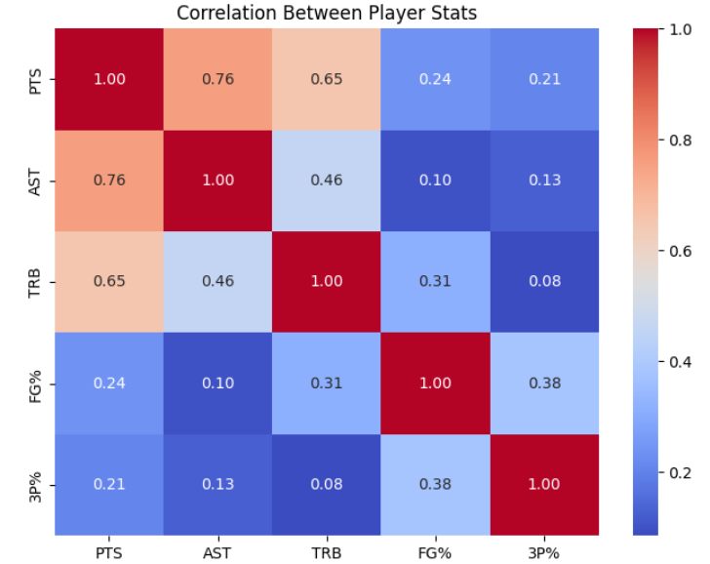
EDA 3. What Factors Influence Performance?
🔑 Key Takeaways: What Factors Influence Performance?
📌 1. Assists (AST) have the strongest correlation with Points (PTS) (0.76)
High scorers are often strong playmakers, indicating that creating shots for teammates aligns with scoring ability.
📌 2. Rebounds (TRB) significantly impact PTS (0.65)
Players who grab more rebounds tend to score more, likely benefiting from second-chance points and dominant inside play.
📌 3. Shooting Efficiency (FG%, 3P%) has a weaker correlation with PTS
FG% (0.24) and 3P% (0.21) suggest that high scorers rely more on shot volume than pure efficiency. This explains why elite scorers (e.g., Luka Dončić, Kevin Durant) take high-volume shots despite varying shooting percentages.
📌 4. Playmaking and Rebounding Overlap
AST and TRB (0.46 correlation) suggest that versatile players (e.g., Nikola Jokić, Luka Dončić) contribute across multiple areas.

Slide 7
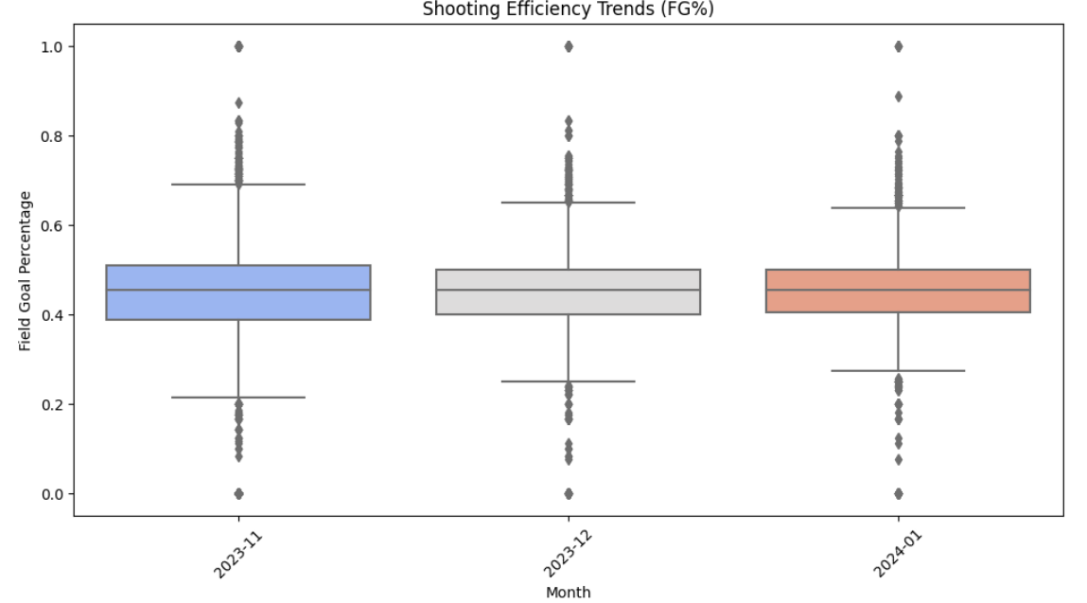
EDA 4. Are Players Becoming Efficient?
🔑 Key Takeaways:
📌 Slight Increase in FG% Over Time
November: 44.60%
December: 44.64% (+0.09%)
January: 45.22% (+1.02%)
Indicates a steady improvement in shooting efficiency as the season progresses.

Slide 8
Statistical Test
1
Anova Test
Is there a significant difference in player performance across months?
2
Regression Analysis
Can we predict a player’s PPG based on assists, rebounds, and efficiency?

Slide 9
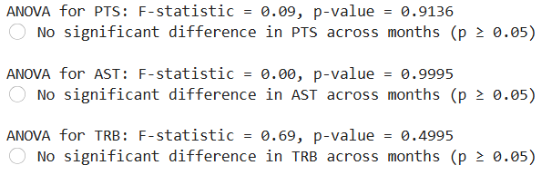
Statistical Analysis – Anova Test
🔑 Key Takeaways:
📌 1. No Significant Monthly Variation in Performance
PTS: F = 0.09, p = 0.9136 → Scoring remains stable across months.
AST: F = 0.00, p = 0.9995 → Assists do not significantly change month to month.
TRB: F = 0.69, p = 0.4995 → Rebounding also shows no major shifts over time.
📌 2. Possible Explanations
Consistent playing styles and team strategies prevent drastic fluctuations.
Players maintain a steady performance level across the season.
Interpretation:
If p-value < 0.05, performance significantly changes across months (e.g., players get better or worse).
If p-value ≥ 0.05, performance is consistent across months (not much variation).

Slide 10
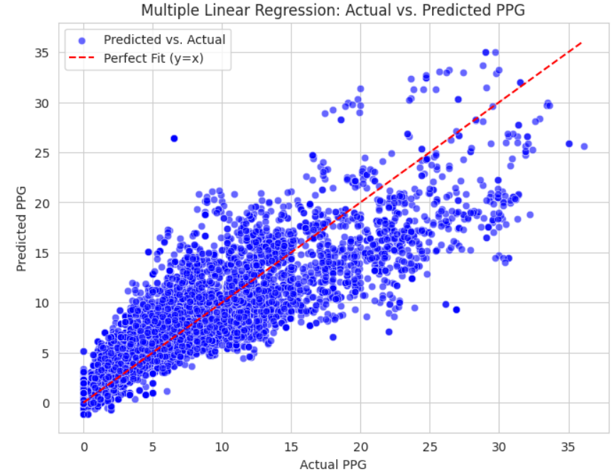
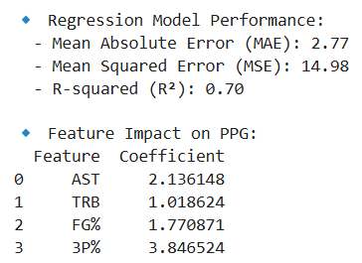
Statistical Analysis – Regression Analysis
🔑 Key Takeaways:
📌 1. Model Performance
- R² = 0.70 → The model explains 70% of the variance in PPG, indicating a strong relationship between stats and scoring ability.
- MAE = 2.77, MSE = 14.98 → Predictions are within ~2.8 points of actual PPG, showing decent accuracy.
📌 2. Key Factors Influencing PPG
- 3P% (3.85 coefficient) → Strongest impact on PPG: players with a higher three-point percentage tend to score significantly more.
- AST (2.14 coefficient) → Higher assists correlate with higher PPG, possibly due to playmakers creating their own shots.
- FG% (1.77 coefficient) → Better shooting efficiency contributes to higher scoring but has less impact than assists and three-pointers.
- TRB (1.02 coefficient) → Rebounds have the least influence on scoring compared to other factors.
📌 3. Insights
- Players with higher 3P% and AST are more likely to be elite scorers.
- Improving shooting efficiency (FG%) could further boost PPG.

Slide 11
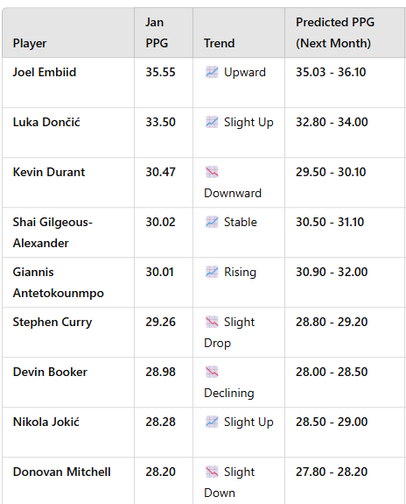
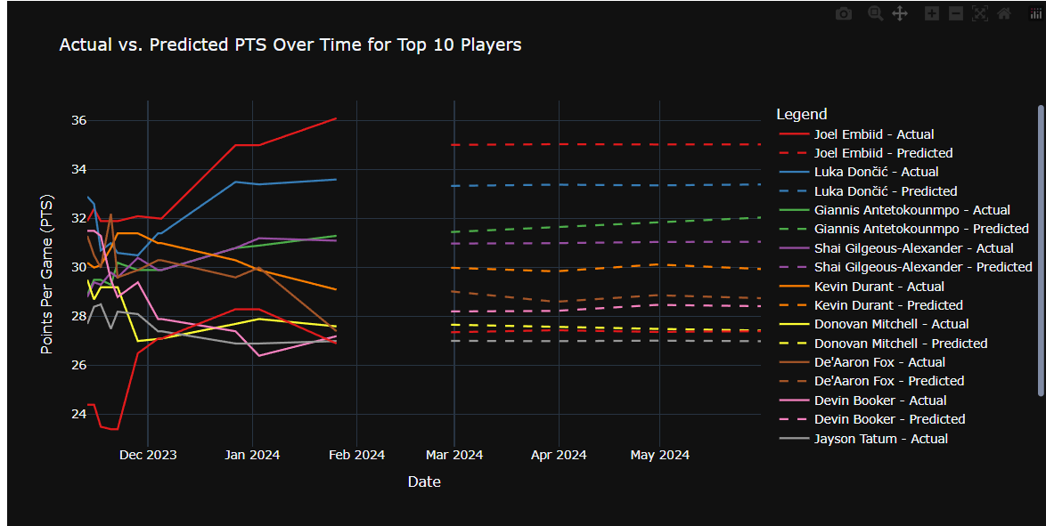
Point Per Game (PPG) Predictions
For NBA Teams & Coaches
Identify players on a scoring upswing (e.g., Embiid, Luka) and design plays around them.
Spot declining scorers (e.g., Booker) and adjust shot distribution.
Use AST/FG% trends to fine-tune offensive strategies.
For Analysts & Sports Bettors
Leverage trends in AST/3P%/FG% for fantasy basketball decisions.
Spot undervalued players who are likely to break out next month.
For Media & Fan Engagement
Predictive storylines: "Which players will dominate in March?"
Comparative analysis: "Who is on pace to be the next scoring champion?"

